Slide 1
Agriculture Financing in Interior Sindh: Understanding the Ground Realities
Presenter: Dr. Abidullah Khan

Slide 2
Background
Sindh has an unavoidable share in the agriculture output.
However, loans disbursed to this province are far lower as compare to Punjab.
Do we need new financial instruments for financing agriculture sector?
Are Islamic Banks able to utilize the agriculture financing properly?
  Do IBs lack Islamic Financial Contracts for agriculture sector?
Conventional Banks are ahead in agriculture financing.

Slide 3
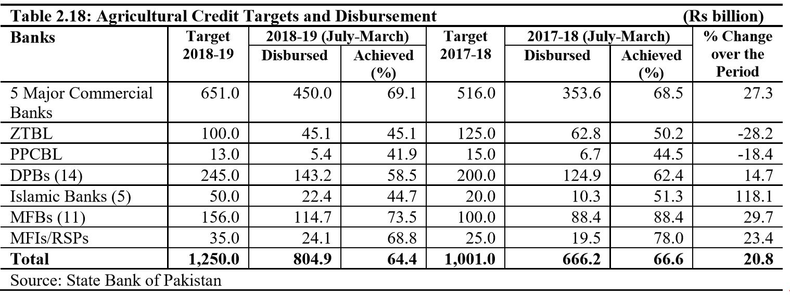
Agriculture Credit Targets – Who is Ahead?

Slide 4
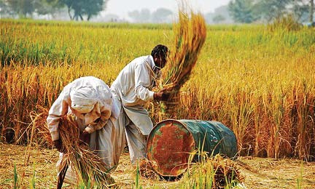
Why Targets are not achieved?
Eligibility criteria issue
Documentation issues
  Need to complete all documents – cumbersome process
  Under the table payments for get 7th form.
The behavior of Bankers
Provision of loan takes long time as compare to informal loan.
Social bonding with informal loan providers.
The loan is not provide in cash but in-kind.
The interest rate charged by informal lenders is usually more than 50%.

Slide 5

Documentation – related to revenue department.
Almost 80% of the cases are rejected due to non-availability of relevant documents.
  Passbook and form 7
Collateral is secondary, the first security is land for which passbook is required.
Moral hazard – Loan utilized for personal use.
Loan recovery is cumbersome process.
Liquidation of land is difficult.

Slide 6
Looking Forward
Does profit rates matter for them?
Does Non-Shari’ah compliant financing an issue?
Lack of Trust?
What is the success factor of MFB and MFIs?
Any Alternative for tackling documentation issue?

